Slide 1
IoT Remote Monitoring Application
For Washing Machines and Dryers
Team 17
SDDEC18-17
Notes:
Thomas

Slide 2
Team Members & Contributions
John Fleiner & Ben Young
Android & iOS
Thomas Stackhouse & Casey Gehling
Spring Boot Web Server
AWS IoT
Hongyi Bian & Yuanbo Zheng
Hardware Implementation
Advisor:
Goce Trajcevski
Client:
Greiner Jennings Holdings
SDDEC18-17
Notes:
Thomas

Slide 3
Outline
Overview
Requirements
Considerations
System Design
System Implementation
Testing
Prototype
SDDEC18-17
Notes:
Thomas

Slide 4
OVERVIEW
1
SDDEC18-17
Notes:
Thomas

Slide 5
Project Overview
Problem Description
Laundromats:
Managing Multiple Locations
Effective Scheduling
Project Goals
Mobile Reservation Application
Appliance Assignment Mechanism
SDDEC18-17
Notes:
Thomas
TODO: include detailed information to problem description

Slide 6
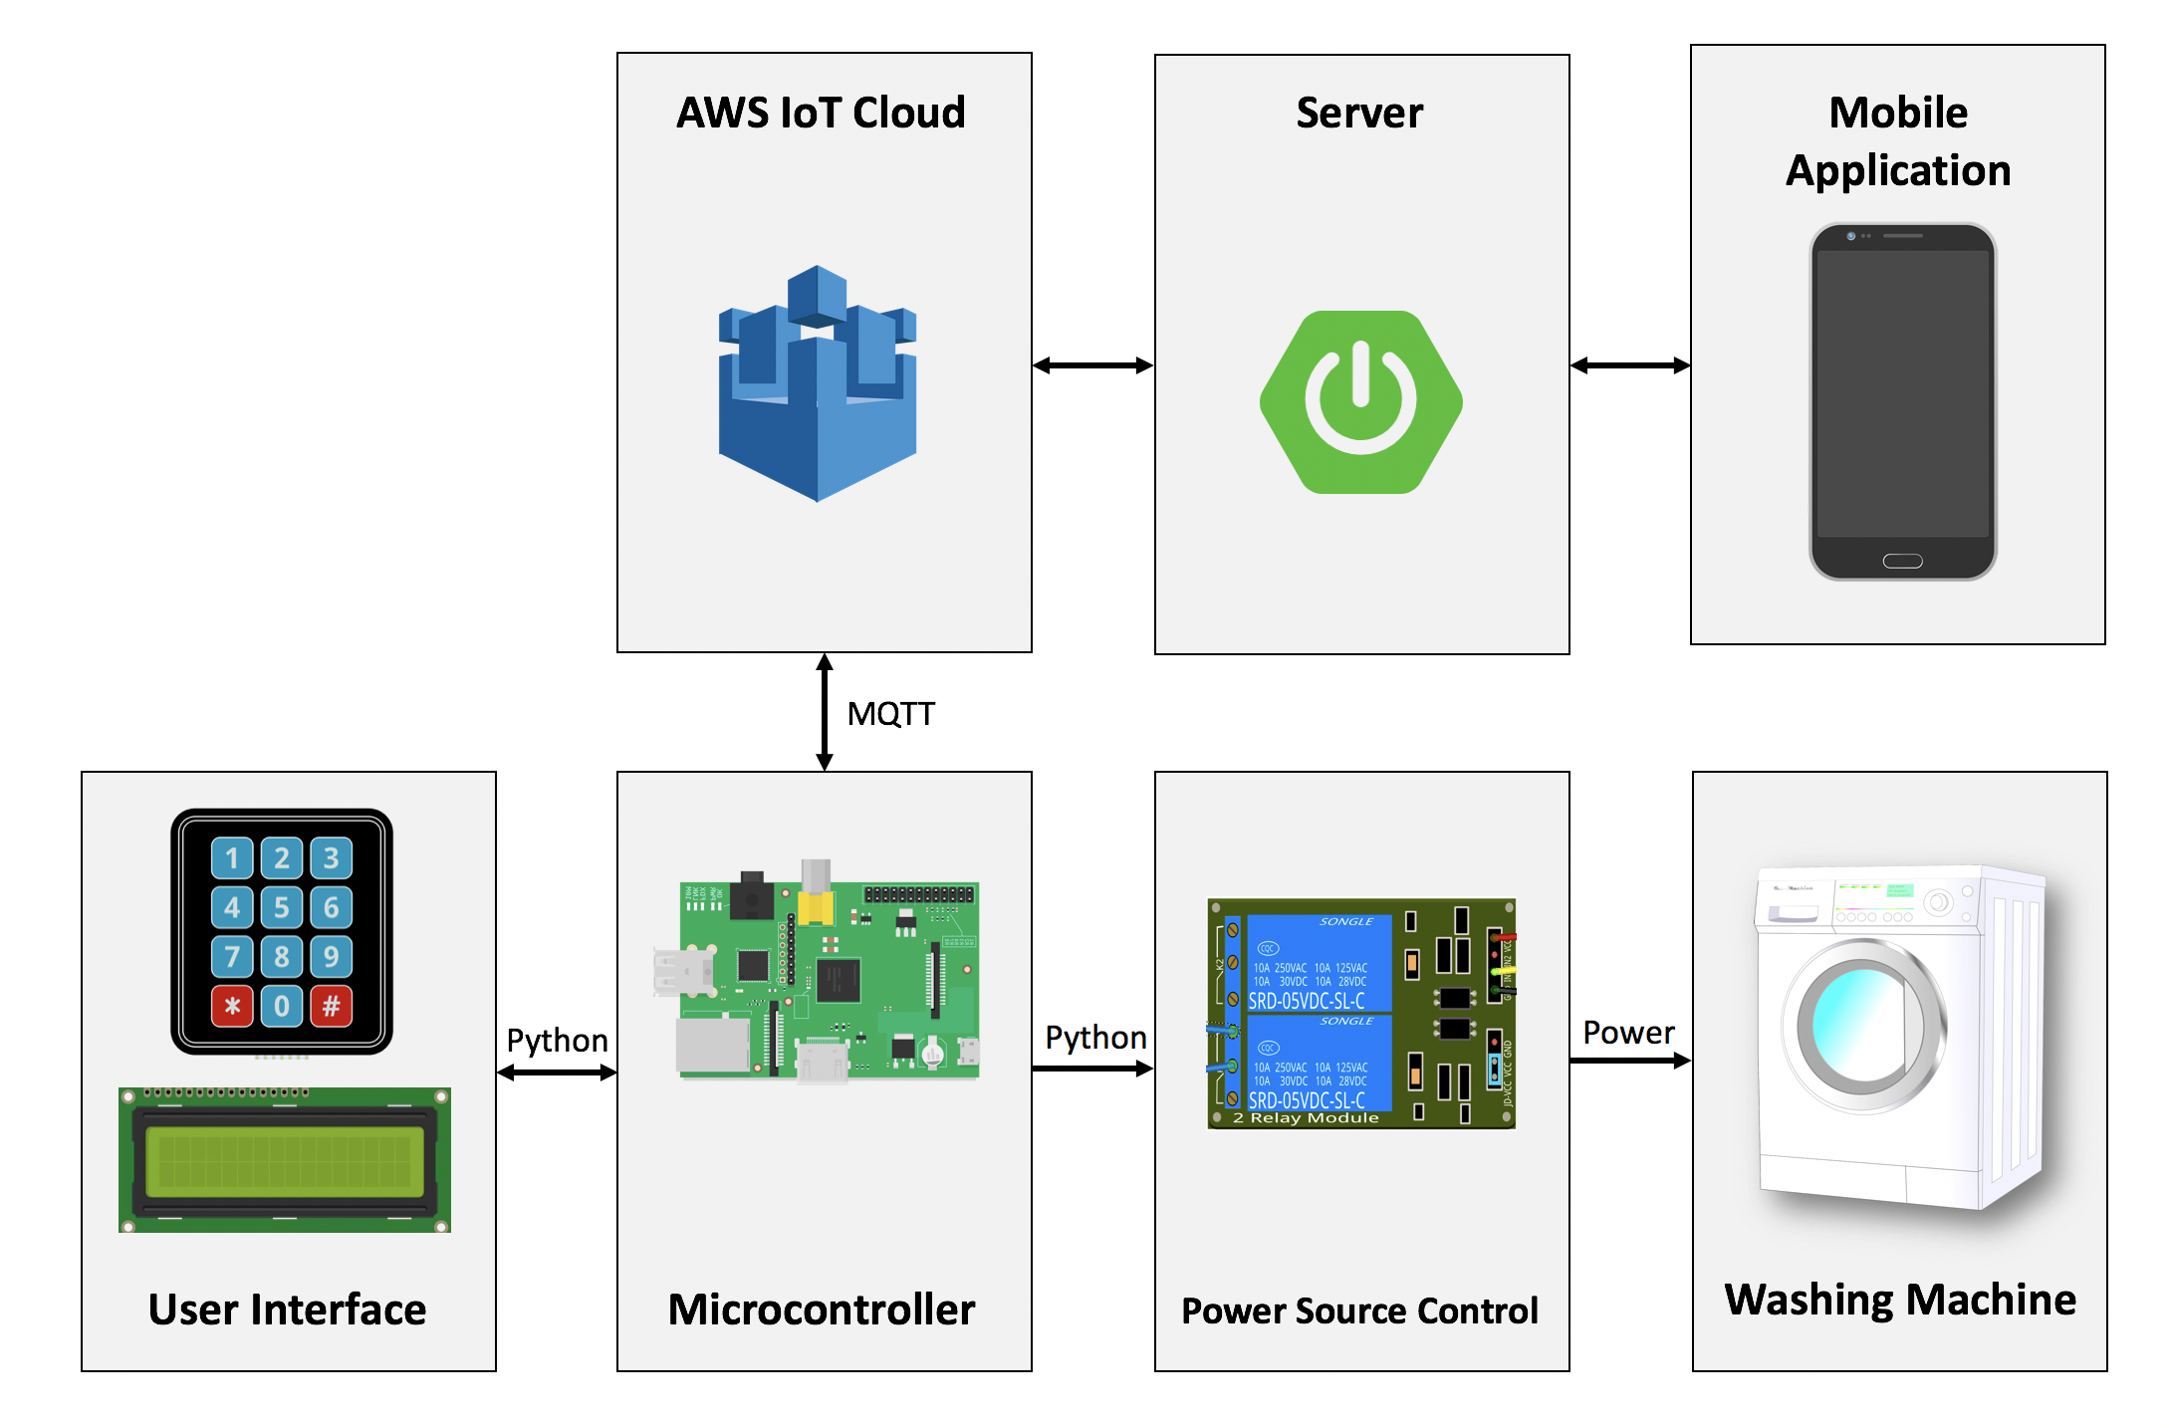
Concept Diagram
SDDEC18-17
Notes:
Casey
Two kinds of user interfaces - keypad lcd and mobile application

Slide 7
REQUIREMENTS
2
SDDEC18-17
Notes:
John

Slide 8
Requirements Specification
Functional Requirements
Create & Pay for Reservation
Reservation Code → Unlock Appliance
Reservation Ends → Lock Appliance
Full List of Requirements on pages 16 - 20
SDDEC18-17
Notes:
John

Slide 9
Requirements Specification
Non-Functional Requirements
Secure Personal Data
Authorized API Access
Commercially Scalable
Full List of Requirements on pages 21 - 22
SDDEC18-17
Notes:
John

Slide 10
Considerations
3
SDDEC18-17
Notes:
John

Slide 11
Market Survey
IoT Pay-per-wash Industry
Subscription based services
Microsoft Azure Berendsen IoT Hotel Laundry Service
IoT tracking on linen ID tags
Samsung Electronic Laundry Innovation
IoT compatible with SmartThing ecosystem
SDDEC18-17
Notes:
John Fleiner

Slide 12
Resource Requirements
Items | Price
Amazon Web Service IoT | $73.67
Portable Washing Machine | $109.97
Raspberry Pi 3 Model B | $35.00
16x2 LCD Display | $9.95
3x4 Matrix Keypad | $7.50
4-Channel Relay Module | $6.97
Basic Electronic Kit | $15.00
Total: | $258.06
SDDEC18-17
Notes:
HongYi

Slide 13
Risks → Mitigations
Privacy
HTTPS, Spring Security Auth
Storing Credit Cards
Database/Transfer Encryption
Accidental Soldering Errors
Backup Hardware
SDDEC18-17
Notes:
HongYi
We should use HTTPS instead of HTTP
When sending credit card information over the network, the data needs to be encrypted and not in plain text
Since our prototype requires, its a good idea to have backup hardware incase things go wrong and stuff breaks

Slide 14
System Design
4
Notes:
Thomas

Slide 15
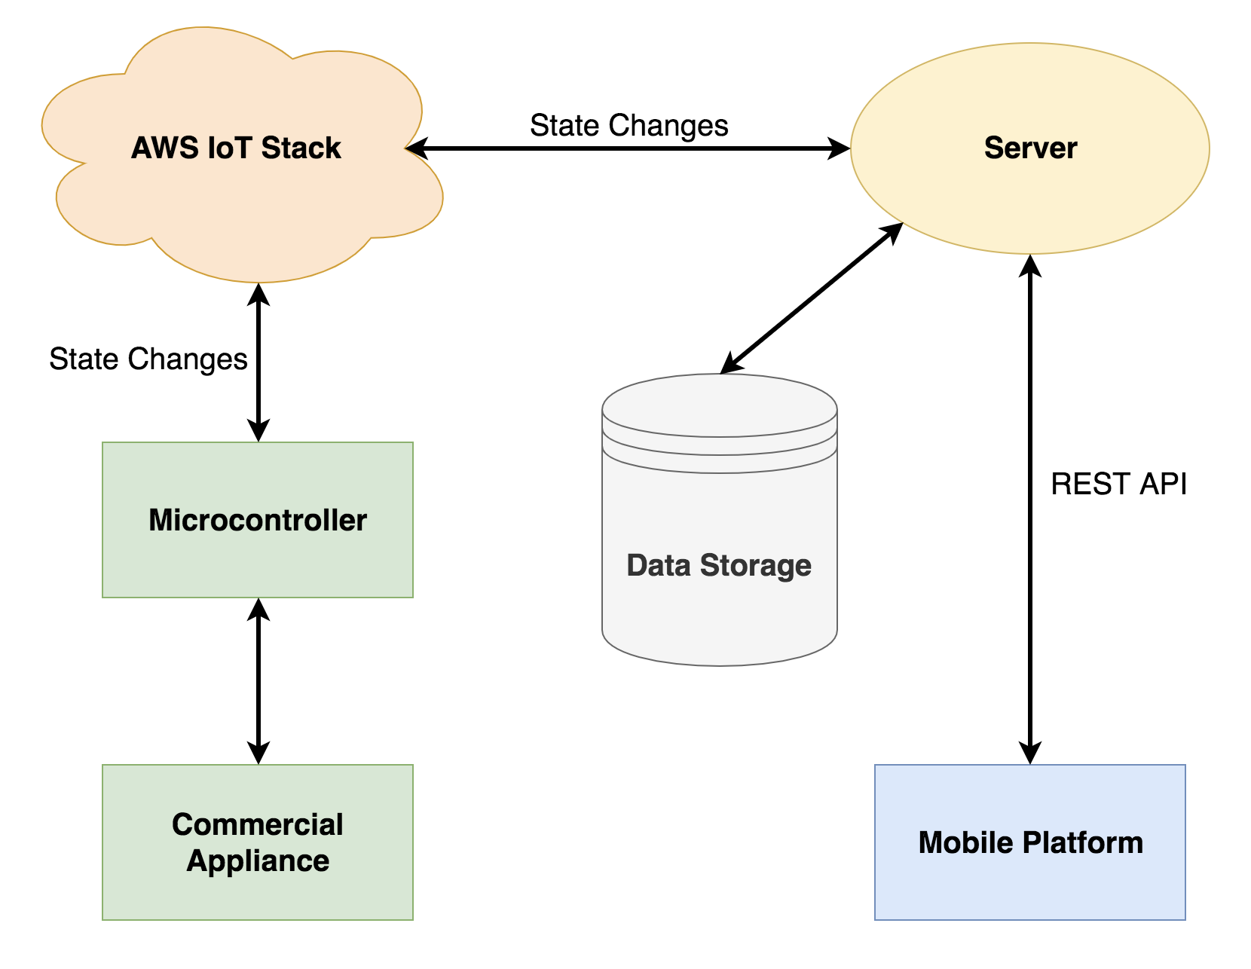
System Architecture & Analysis
Mobile
Android/iOS Native Apps
Backend
Spring Boot Web Server
AWS IoT
MYSQL DB
Hardware
Raspberry Pi 3
Washing Machine
Keypad & LCD
SDDEC18-17
Notes:
Thomas

Slide 16
Design Trade Offs
Spring Server vs Calling DB Directly
Centralized & Scalable
Prior Experience
Separating Visualization and Computation
Native Applications vs Cross Platform
Implementation-Specific Functionality
Added Maintenance
Cloud Provider - AWS IoT
Clients’ Request
Prior Experience
SDDEC18-17
Notes:
Thomas
Trade-offs: just say we are showing the trade-offs the influence the design decisions. Talking about trade-offs for design decisions. Why we designed it the way we did

Slide 17
System Implementation
5
SDDEC18-17
Notes:
Ben

Slide 18
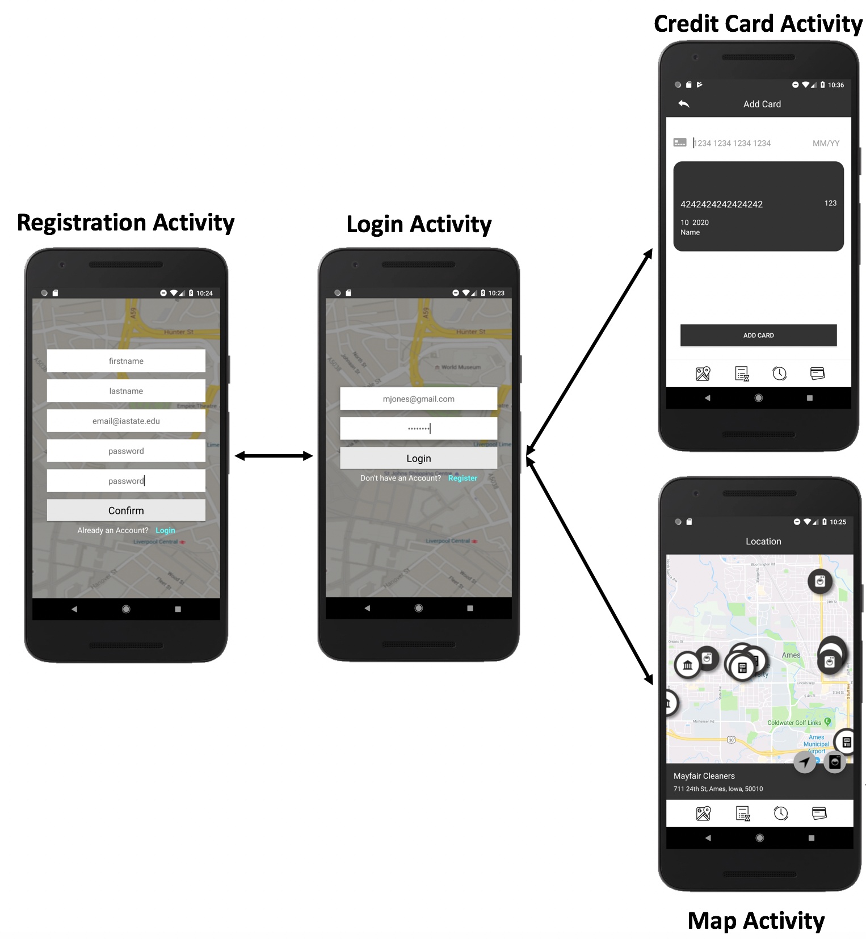
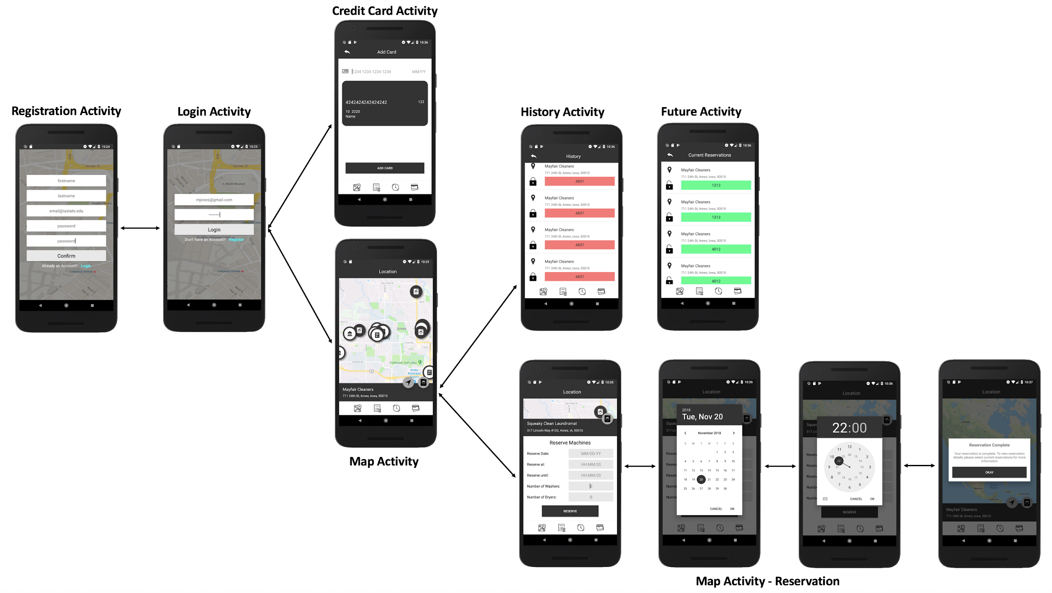
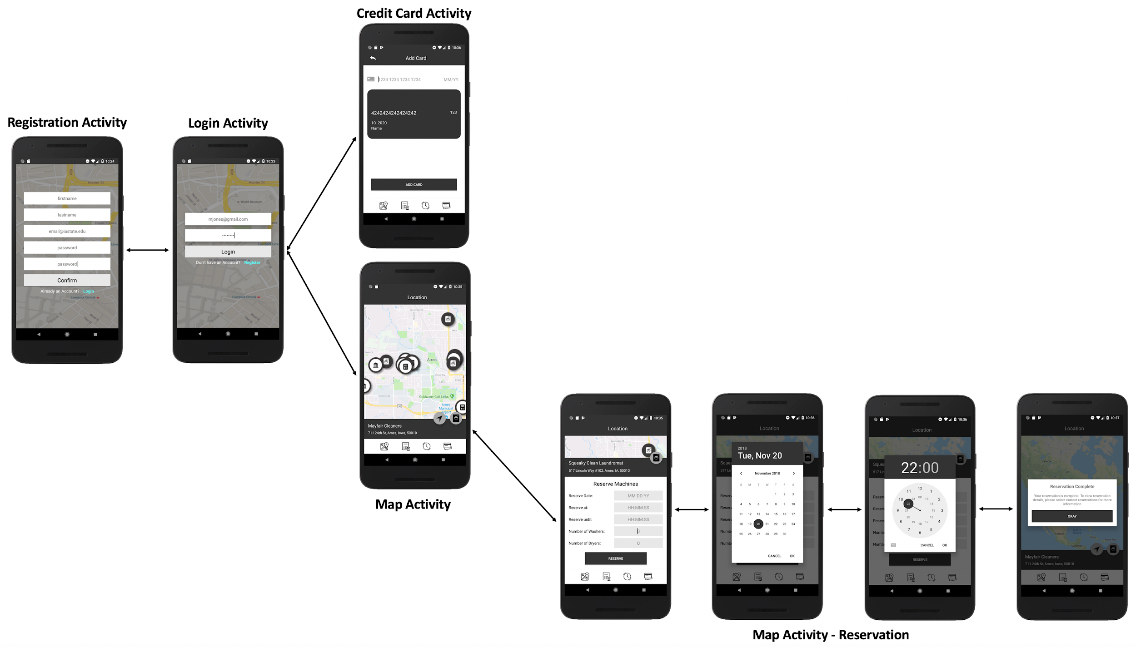
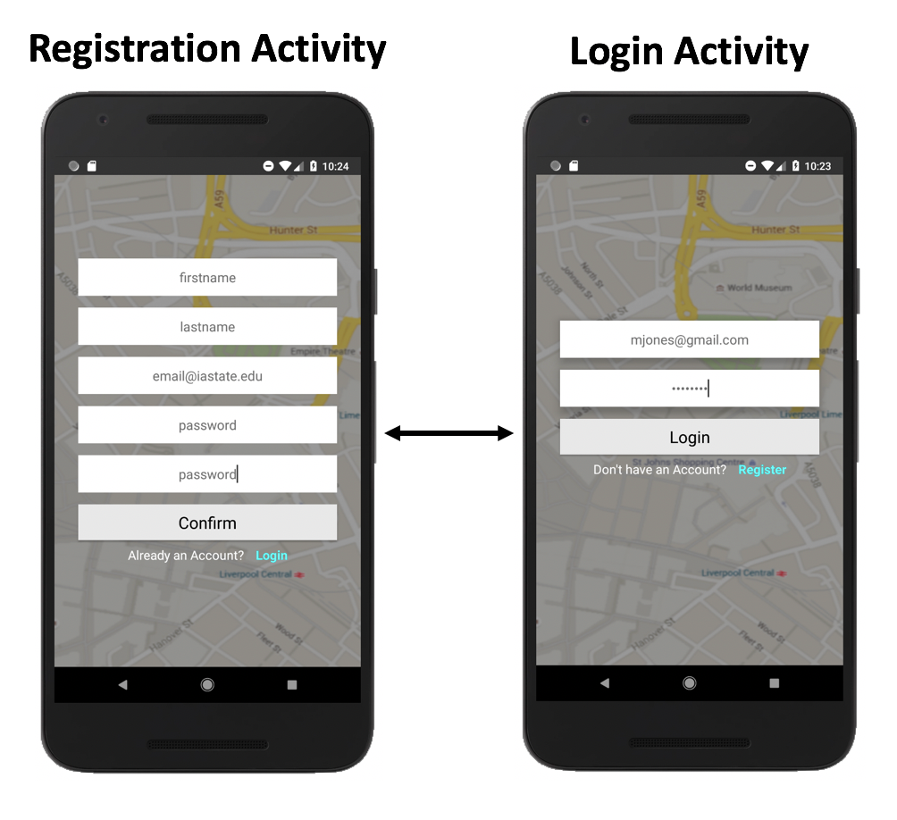
Customer Interface
SDDEC18-17
Notes:
Ben
Say verbally - we showed the user perspective of a workflow, and a system perspective, and now the details. We start with the user interface
Mention what programming languages and IDEs we used to develop.
Explain process flow and what each screen does.

Slide 19
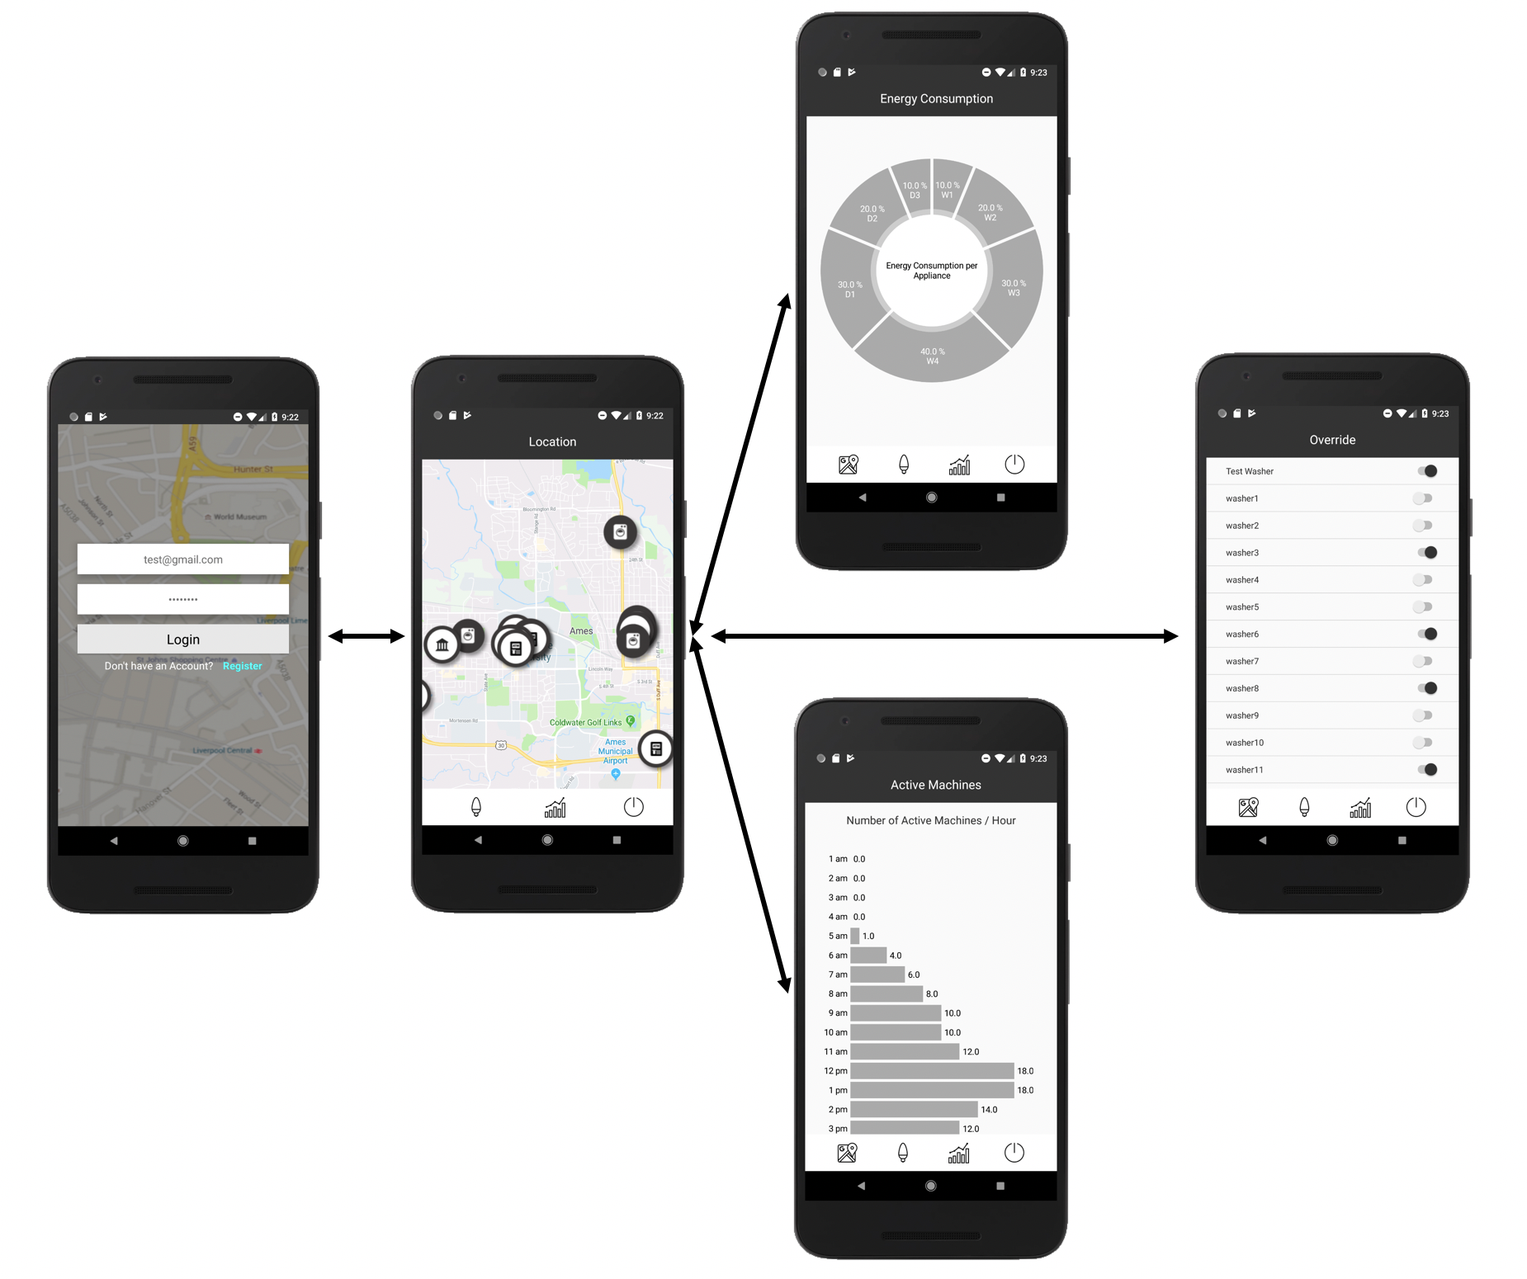
Admin Interface
SDDEC18-17
Notes:
Ben

Slide 20
Mobile Implementation
SDKS
Stripe SDK (Payment Transaction Service)
Google Maps SDK
Libraries
MPAndroidCharts
Charts
SDDEC18-17
Notes:
Ben

Slide 21
Backend Design
Web Server
Spring Boot Web Server (SBWS)
Cloud Service
Cloud Hosting (AWS)
Database
MySQL External Database
Communication
MQTT Integration
SDDEC18-17
Notes:
Casey
Remind

Slide 22
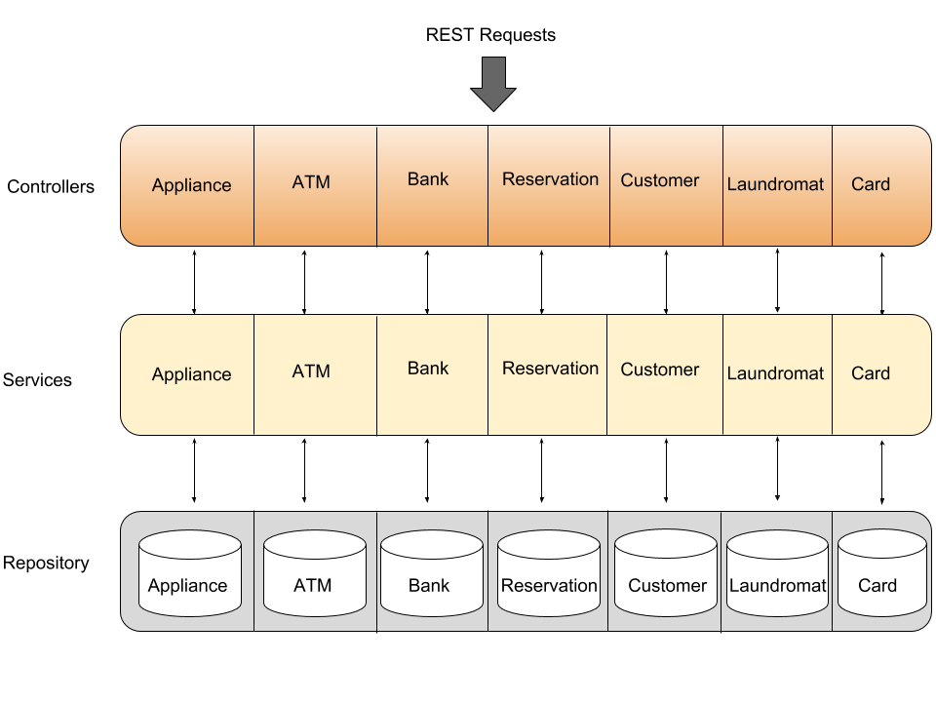
Backend Diagram
SBWS
AWS
MySQL
MQTT
SDDEC18-17
Notes:
Casey

Slide 23
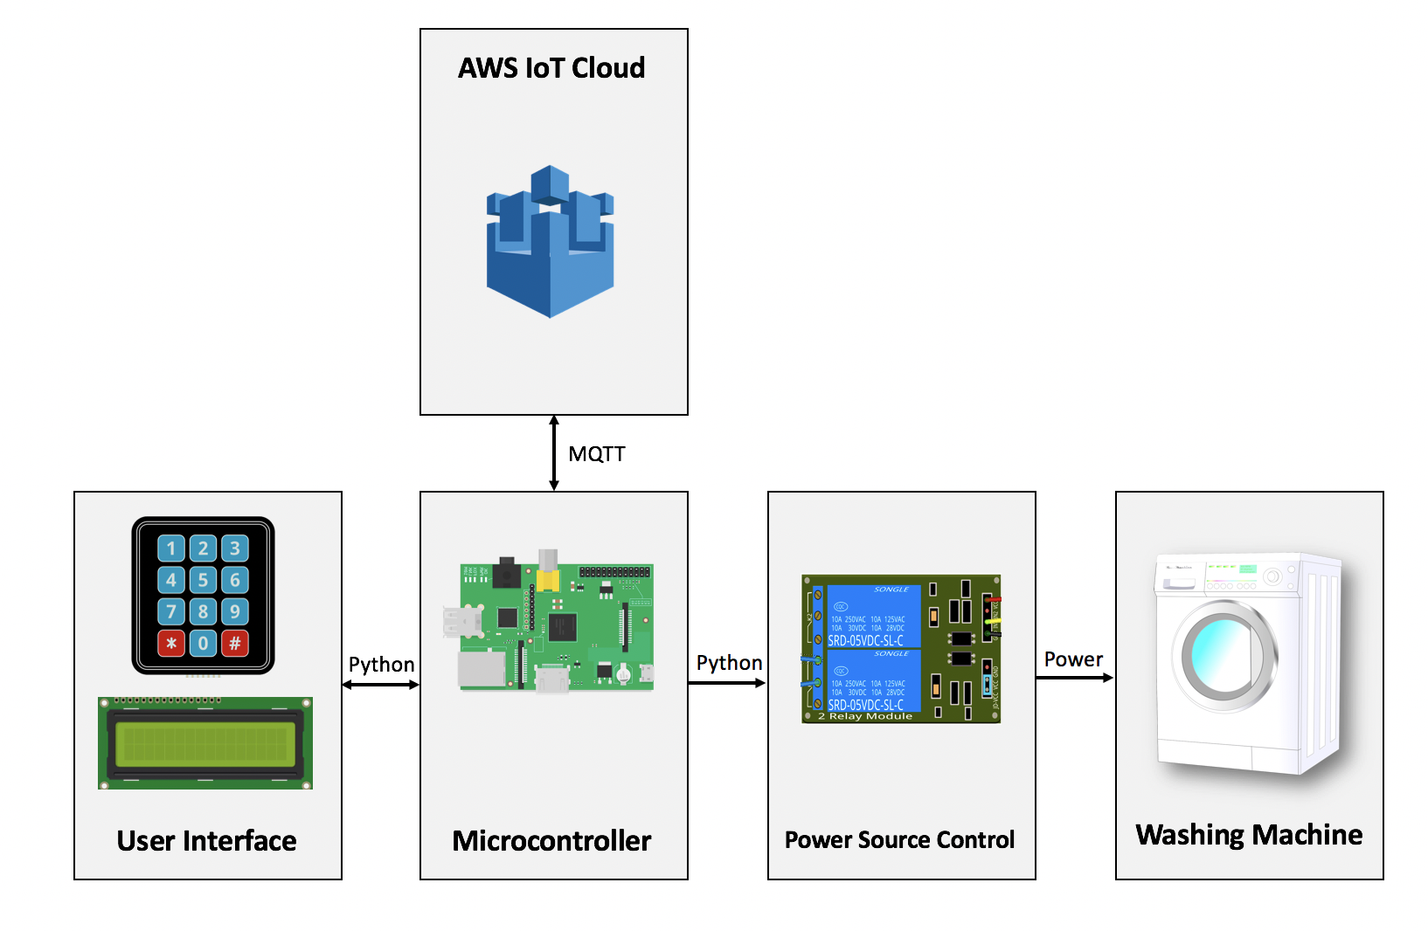
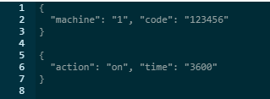
Hardware Concept Diagram
SDDEC18-17
Notes:
Hongyi

Slide 24
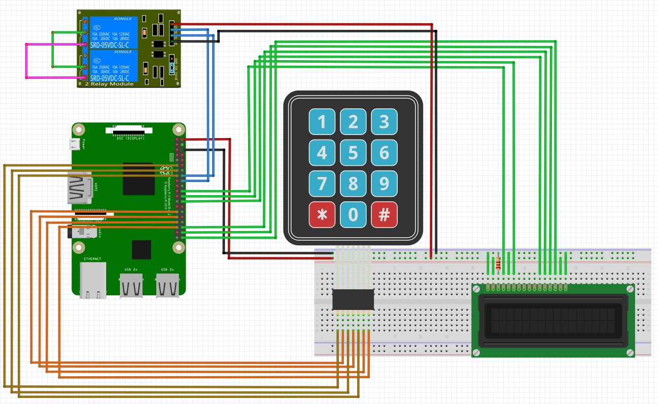
Electronic Diagram
RPi 17/40 pins
6 → LCD
7 → Keypad
2 → Relay
2 → 5V Power
SDDEC18-17
Notes:
Hongyi
Remind them that we discussed the trade-offs and this is but another instance of the trade offs
Talk about why we chose the raspberry pi over arduino, etc

Slide 25
Testing
6
SDDEC18-17
Notes:
John

Slide 26
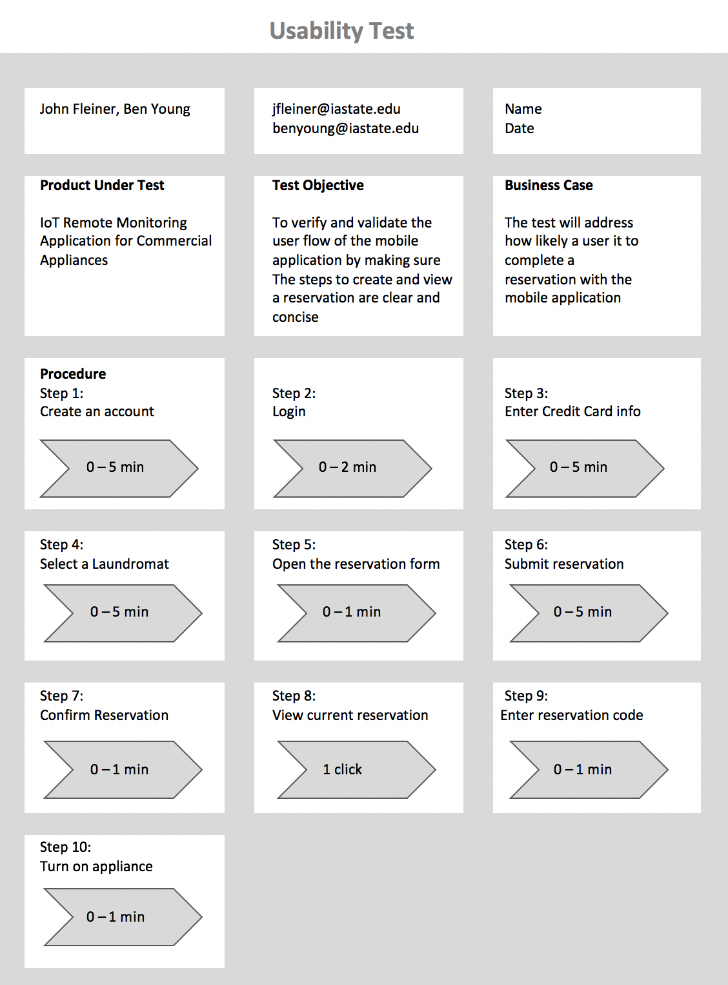
Mobile Usability Testing
Summary
On Average 7/9 Tests Originally Passed
Detailed Results
Please refer to pages 64 - 67 for more detail
SDDEC18-17
Notes:
John

Slide 27
Mobile Unit Testing
is_reservation_num_appliances_valid() | Given a request for 1000 machines, verify that the applications displays a warning and prevents a reservation from being created | False | False
is_reservation_valid_card() | Given a valid reservation, but an invalid credit card, verify that the applications displays a warning and prevents a reservation from being created | False | False
Summary
21/28 Tests Originally Passed
75% Success Rate
Detailed Results
Please refer to pages 67 - 71 for more detail
SDDEC18-17
Notes:
John

Slide 28
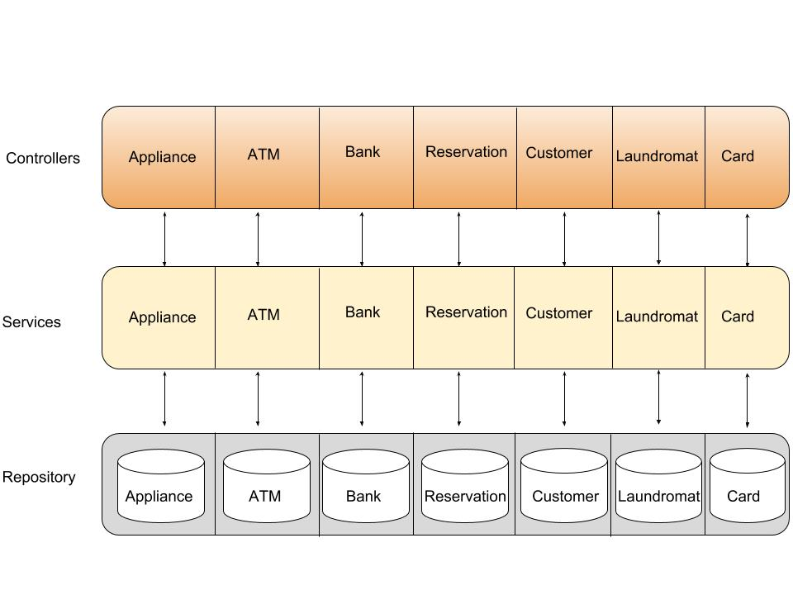
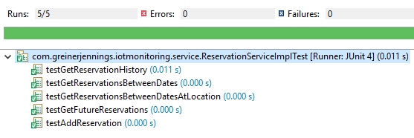
Backend Testing & Results
Completed JUnit Testing
Service Layer
Repository Layer
SDDEC18-17
Notes:
Casey

Slide 29
Hardware Testing
Onboard Scripts Testing
Python Scripts
Shell Scripts
Circuit Functionality Testing
Relay Module
LCD Screen
Keypad
SDDEC18-17
Notes:
Yuanbo

Slide 30
Lessons Learned & Client Feedback
Lessons Learned
Soldering: Delicate Work
Many UI Iterations
Client Feedback
Pleased with Prototype
Un-concerned of Scalability
SDDEC18-17
Notes:
Yuanbo

Slide 31
Prototype
7
SDDEC18-17
Notes:
Ben

Slide 32
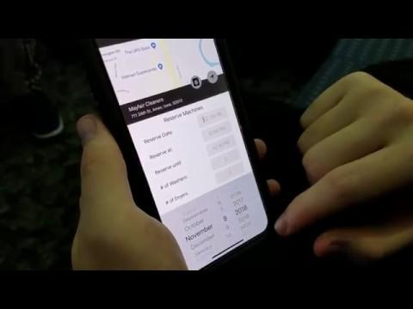
Prototype Demo
SDDEC18-17
Notes:
Ben

Slide 33
Future Work - Commercialization
Commercialization
Data Privacy Enhancements
AWS Scalability
Future Work
Surge Pricing
Hardware Usage Analytics
Multi-Location Analytics
SDDEC18-17
Notes:
Thomas
Potential Enhancements:
Multi-location analytics
Recommendation System, Suge Price System

Slide 34
THANKS!
Any questions?
sddec18-17@iastate.edu
SDDEC18-17
Notes:
Thomas

Slide 35
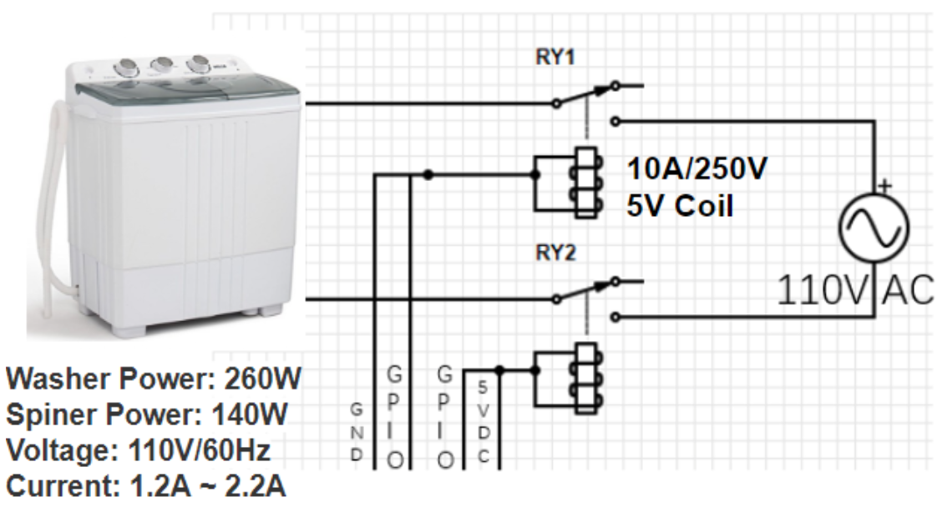
Circuit Diagram
SDDEC18-17
Notes:
Hongyi
Remind them that we discussed the trade-offs and this is but another instance of the trade offs
Talk about why you chose 4-channel relay module

